Slide 1
Xunzi on Ritual, Situationism, Transformation
Phil 210, Fall 2025

Slide 2
Overview of Today
Xunzi’s picture of psychology
What we should do
How this works
“Progressive Confucianism”?
For poll:
When active, respond at PollEv.com/tirani111 or text tirani111 to 37607 once to join

Slide 3

Human Nature is … Bad?
“Humans are born having desires. When they have desires but do not get the objects of their desire, then they cannot but seek some means of satisfaction. If there is no measure or limit to their seeking, then they cannot help but struggle with each other. If they struggle with each other then there will be chaos….” (Xunzi 19, ll. 1-5)
Notes:
What is “evil”? What is it to be innately bad or evil? Xunzi is only saying that without intervention, things end up bad.

Slide 4
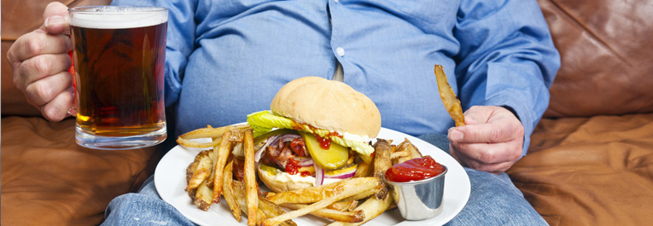
Nature vs. Disposition
Nature (xing 性): “that which is so at birth” (Xunzi 22)
Disposition (qing 情): initially identical to xing, but can be changed.

Slide 5
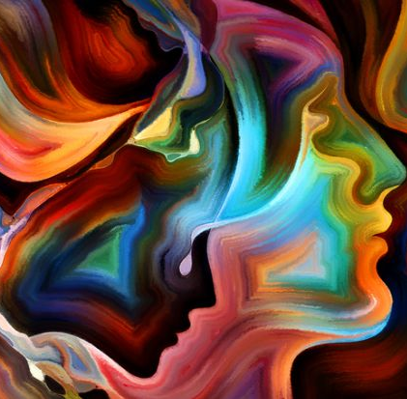
Not just physical desires…
“Sprouts” or “beginnings” (duan 端) of joy and sorrow (p. 210, l. 350)
“Loving differentiations” (好其别) (p. 201, l. 19); see also Xunzi 9 on humans’ difference from “birds and beasts”: distinctions and communities
Ability of heartmind to “approve” (ke 可) or “disapprove” (Xunzi 21)

Slide 6
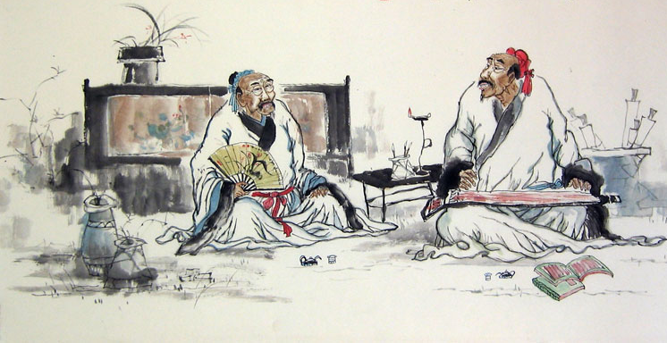
Mengzi vs. Xunzi on psychology
Likelihood of desires to lead us astray
Substance of the sprouts (moral vs. neutral)
Role of differentiation/distinction (though cf. Mengzi on “disdain”)
Neither sees evil or sin as innate or inevitable

Slide 7
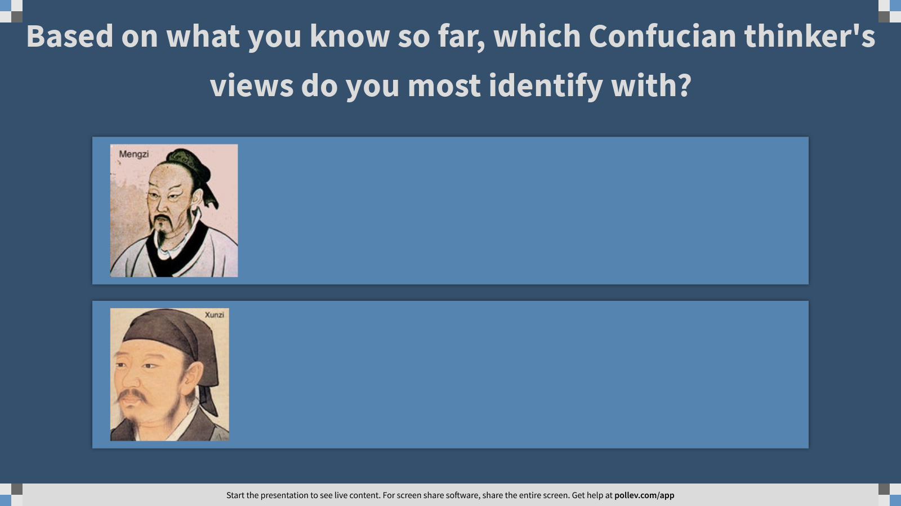
Notes:
Based on what you know so far, which Confucian thinker's views to you most identify with?
https://www.polleverywhere.com/multiple_choice_polls/Q0Lb8GF9fSXlR52MInbf6?display_state=instructions&activity_state=opened&state=opened&flow=Engagement&onscreen=persist

Slide 8
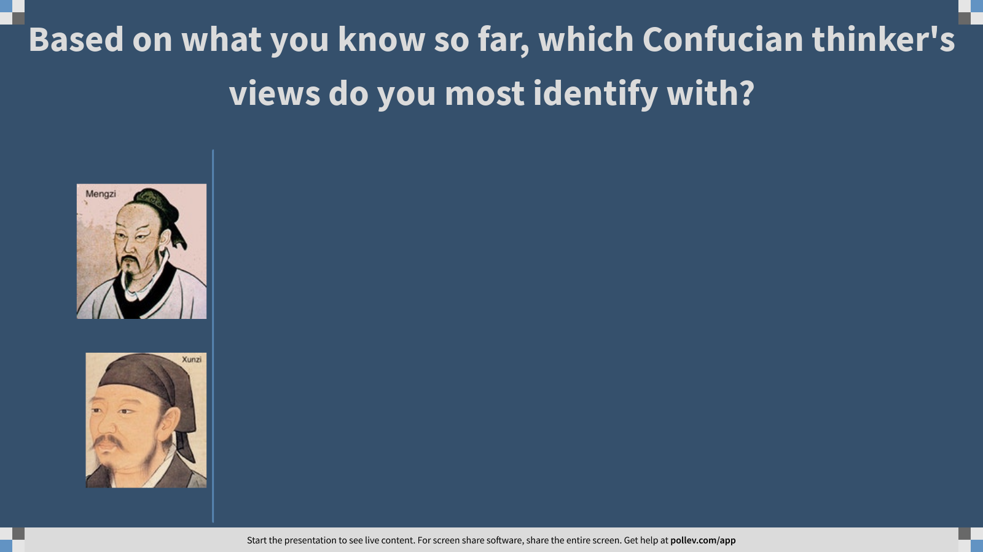
Notes:
Based on what you know so far, which Confucian thinker's views to you most identify with?
https://www.polleverywhere.com/multiple_choice_polls/Q0Lb8GF9fSXlR52MInbf6?display_state=chart&activity_state=opened&state=opened&flow=Engagement&onscreen=persist

Slide 9

Notes:
Based on what you know so far, which Confucian thinker's views to you most identify with?
https://www.polleverywhere.com/multiple_choice_polls/Q0Lb8GF9fSXlR52MInbf6?display_state=chart&activity_state=closed&state=closed&flow=Engagement&onscreen=persist

Slide 10
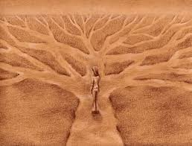
If our nature is bad, what do we do?

Slide 11
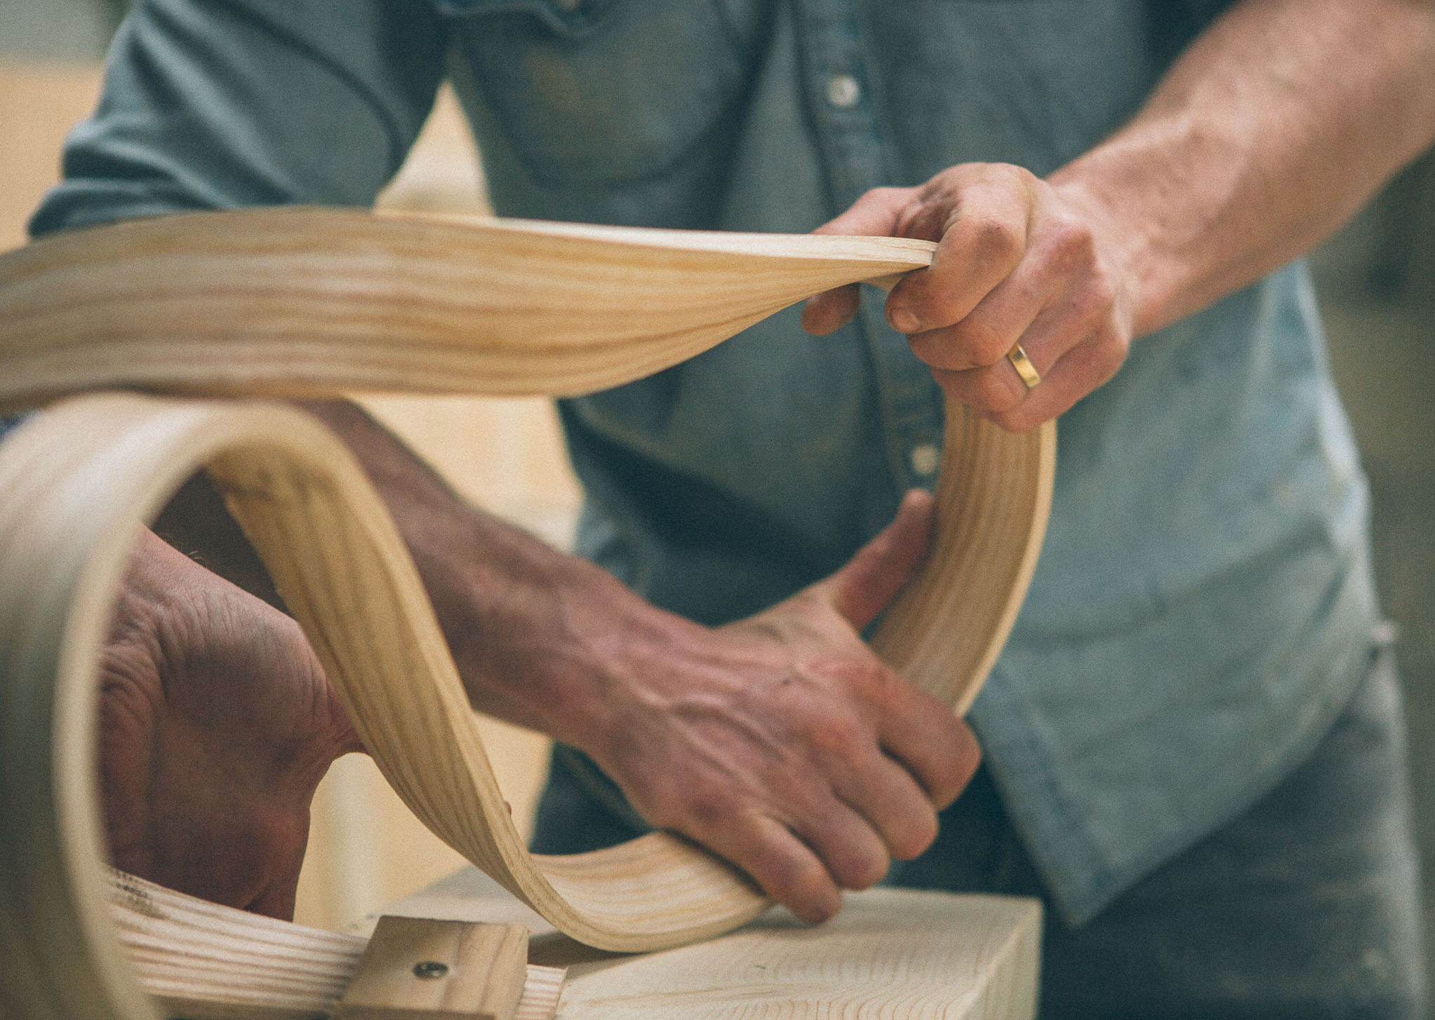
If our nature is bad, what do we do?
Option 1: Transform through learning
Notes:
Through steaming and bending, you can make wood as straight as an ink-line1 into a wheel. And after its curve conforms to the compass, even when parched under the sun 5 it will not become straight again, because the steaming and bending
have made it a certain way.

Slide 12
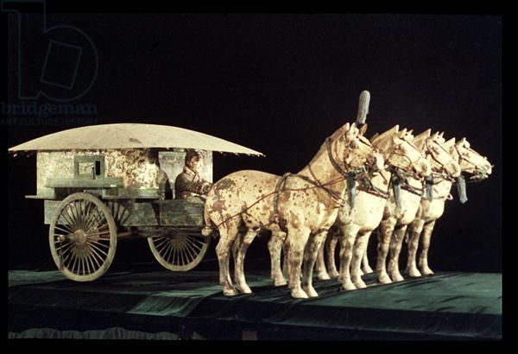
If our nature is bad, what do we do?
Option 1: Transform through learning
Option 2: Change one’s situation
Notes:
One who makes use of a chariot and horses has not thereby improved his feet, but he can now go a thousand li.

Slide 13
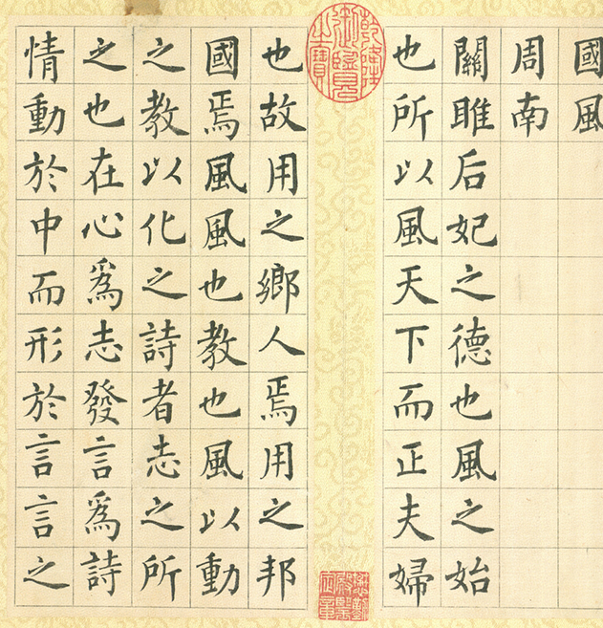
Learning: Role Models and Texts
“Rituals and music provide proper models but give no precepts. The Odes and Documents contain ancient stories but no explanation of their present application…. However, if you imitate the right person in his practice of the precepts of the gentleman, then you will come to honor these things for their comprehensiveness and see them as encompassing the whole world.” (p. 6, ll. 160f)

Slide 14
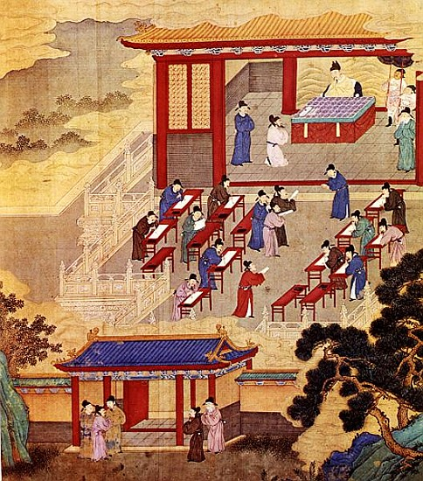
Learning: Transformation
(P. 8, l. 218f) Repetition, pondering, …
“He comes to the point where he loves it, and then his eyes love it more than the five colors…”
“…power and profit cannot sway him, the masses cannot shift him, and nothing in the world can shake him. He lives by this, and he dies by this. This is called the state in which virtue has been grasped.”

Slide 15
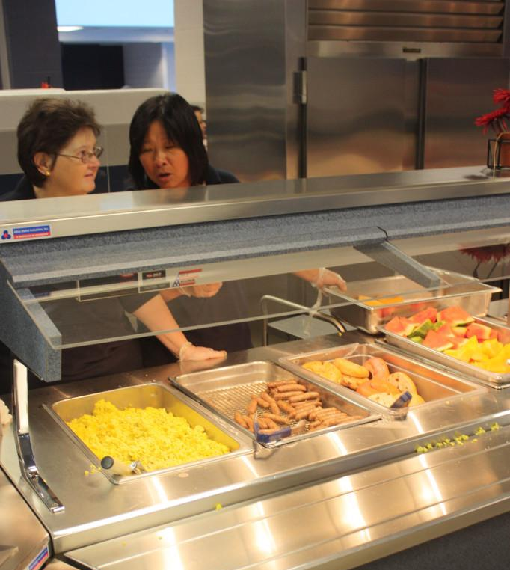
Situations: Evidence from social psychology and behavioral economics
Old models: individual character traits and egoistic interest-maximizer
“Situationism” versus “virtue ethics”
“Choice architecture” (Thaler and Sunstein, Nudge)

Slide 16
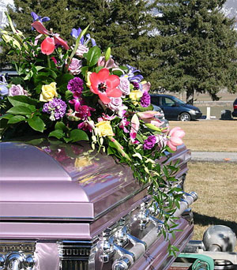
Rituals: Evidence from Xunzi
“Thus, the way that death works is that if one does not ornament the dead, then one will come to feel disgust at them, and if one feels disgust, then one will not feel
sad.”
(Xunzi p. 209, ll. 289f)

Slide 17

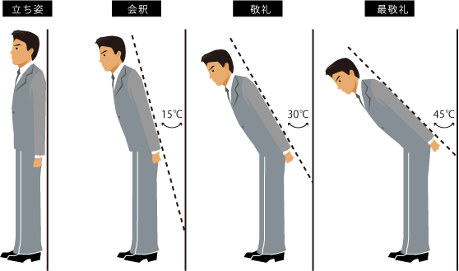
The Functions of Rituals
Using (or “nurturing”) “that which must be released” by “giving it proper form” (p. 204, ll. 119f)
Discipline self and others (by shaping situation)
Shorthand way of expressing feelings
Basis for transformation

Slide 18
Mengzi vs. Xunzi on therapy
Agricultural vs craft metaphors
Role of reflection
Importance of external models
Sagehood is a goal for both

Slide 19
Challenges for Confucianism as a Way of Life

Slide 20
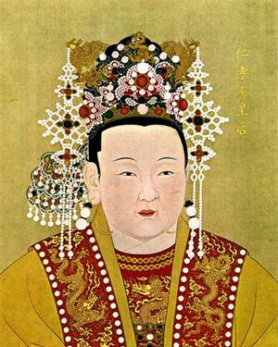
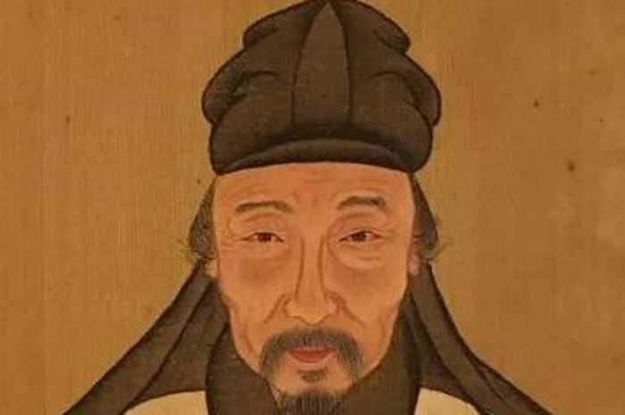
Confucians as Socio-Political Critics?
Speaking truth to power…
Fang Xiaoru (1357-1402)
Demanding equal moral status for women…
Empress Renxiaowen (1362-1407)

Slide 21
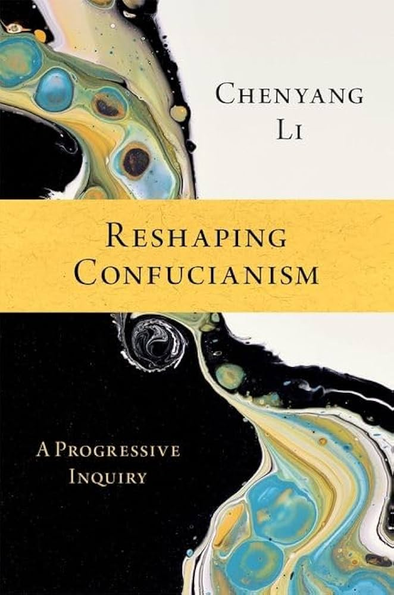
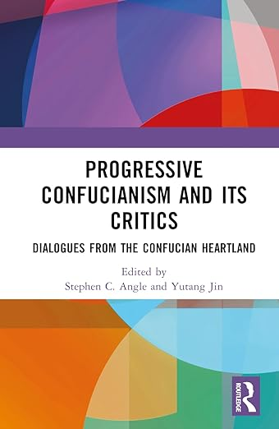
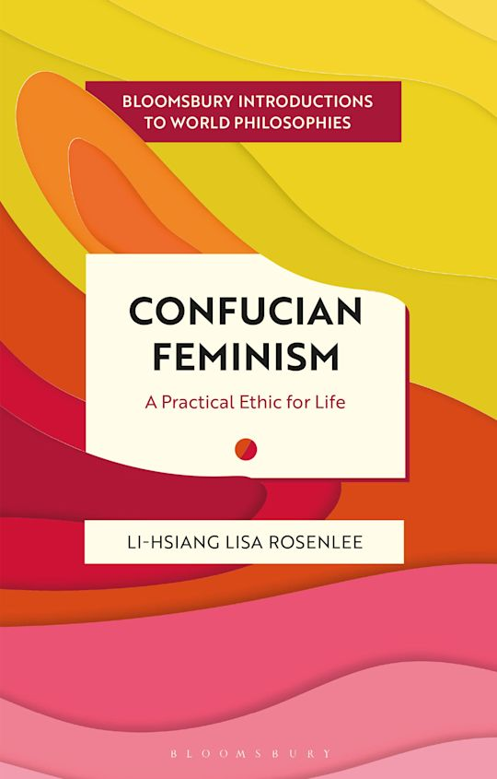
Progressive Confucianism?
Did pre-modern Confucian social critics go far enough?

Slide 22
Progressive Confucianism?
Did pre-modern Confucian social critics go far enough?
“Progressive Confucians” say no … for Confucian reasons

Slide 23
Progressive Confucianism?
Did pre-modern Confucian social critics go far enough?
“Progressive Confucians” say no … for Confucian reasons
For example: if our social circumstances and opportunities for public engagement influence our ability to mature as moral beings … and all of us have equal moral potential … then unequal limits coded into social/institutional settings should be criticized

