Slide 1
Tradition and Change in Early Confucianism
Phil 210, Fall 2025

Slide 2
Overview of Today
The Context of Classical Confucianism
Kongzi and the Analects on Tradition, Moral Growth, and Filial Piety
Mengzi on our emotional starting points, “great” versus “petty” parts, and Mengzian psychology

Slide 3

Classical Confucianism – Social Context
Early Zhou (c. 1000 BCE)
Gradual changes
Decline of central power
Growth of population and social complexity
Feudal “lords” aspire to be kings

Slide 4
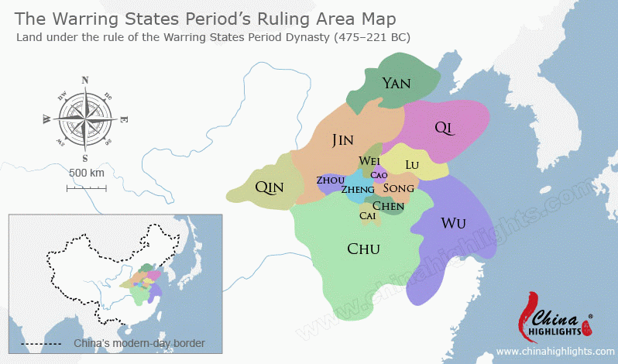
Classical Confucianism – Social Context
Early Zhou (c. 1000 BCE)
Gradual changes
Decline of central power
Growth of population and social complexity
Feudal “lords” aspire to be kings
Warring States Era (5th-3rd c. BCE)

Slide 5
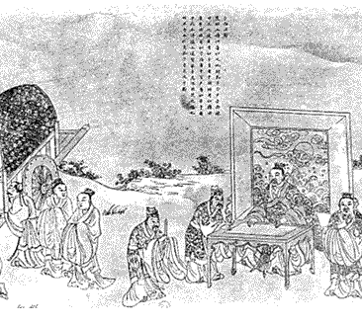
Classical Confucianism
Kongzi 孔子 (or Confucius), 551 – 479 BCE, pronounced kong-dz
Mengzi 孟子 (or Mencius), 4th c. BCE, pronounced mung-dz
Xunzi 荀子, 3rd c. BCE, pronounced hsün-dz
The Way (dao 道) – cp. w/ Plato’s “the Good”? – seems lost:
Learn from past
Theorize/articulate the Way
Teach the theory and practice

Slide 6
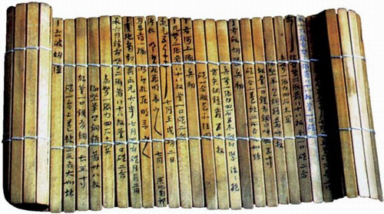
Classical Confucianism – Genres
Collected sayings … often with little context
Edited, commented upon, re-arranged … perhaps for decades or longer
Xunzi is more thematic

Slide 7

Kongzi /Analects: Tradition and Change
2:11 One who reanimates [lit. warms up] the old in order to understand the new — such a person can be called a teacher.
7:1 The Master said, I transmit rather than invent. I trust in and love the ancient ways. I might thus humbly compare myself to Old Peng.
9:3 The Master said, A ceremonial cap made of linen is prescribed by the rituals, but these days people use silk. This is frugal and I follow the majority. To bow before ascending the stairs is what is prescribed by the rituals, but these days people bow after ascending. This is arrogant and — though it goes against the majority — I continue to bow before ascending.
15:36 The Master said, When it comes to benevolence, defer to no one, not even one’s teacher.

Slide 8
Kongzi /Analects: Growing Over One’s Lifespan
2:4 The Master said, ‘At fifteen I set my heart on learning; at thirty I took my stand; at forty I came to be free from doubts; at fifty I understood the Decree of Heaven; at sixty my ear was attuned; at seventy I followed my heart's desire without overstepping the line.'

Slide 9
Kongzi /Analects: Filial Piety (Xiao 孝)
2:5. Meng Yizi asked about filiality. The Master said, Never disobey.
[…Later,] Fan Chi said, What does that mean? The Master said, When they are alive, serve them with propriety; when they are dead, inter them with propriety, and sacrifice to them with propriety.
2:7. Zi You asked about filiality. The Master said, The filiality of the present day: it is merely what one might call being able to provide nourishment. But if we consider the dogs and horses, they all get their nourishment. If there is no respect, where is the difference?
4.18 The Master said, In serving your parents you may gently remonstrate with them. However, once it becomes apparent that they have not taken your criticism to heart you should be respectful and not oppose them, and follow their lead diligently without resentment.

Slide 10
Kongzi /Analects: Filial Piety (Xiao 孝)
2:5. Meng Yizi asked about filiality. The Master said, Never disobey.
[…Later,] Fan Chi said, What does that mean? The Master said, When they are alive, serve them with propriety; when they are dead, inter them with propriety, and sacrifice to them with propriety.
2:7. Zi You asked about filiality. The Master said, The filiality of the present day: it is merely what one might call being able to provide nourishment. But if we consider the dogs and horses, they all get their nourishment. If there is no respect, where is the difference?
4.18 The Master said, In serving your parents you may gently remonstrate with them. However, once it becomes apparent that they have not taken your criticism to heart you should be respectful and not oppose them, and follow their lead diligently without resentment.

Slide 11
Kongzi /Analects: Filial Piety (Xiao 孝)
2:5. Meng Yizi asked about filiality. The Master said, Never disobey.
[…Later,] Fan Chi said, What does that mean? The Master said, When they are alive, serve them with propriety; when they are dead, inter them with propriety, and sacrifice to them with propriety.
2:7. Zi You asked about filiality. The Master said, The filiality of the present day: it is merely what one might call being able to provide nourishment. But if we consider the dogs and horses, they all get their nourishment. If there is no respect, where is the difference?
4.18 The Master said, In serving your parents you may gently remonstrate with them. However, once it becomes apparent that they have not taken your criticism to heart you should be respectful and not oppose them, and follow their lead diligently without resentment.

Slide 12
Kongzi /Analects: Filial Piety (Xiao 孝)
2:5. Meng Yizi asked about filiality. The Master said, Never disobey.
[…Later,] Fan Chi said, What does that mean? The Master said, When they are alive, serve them with propriety; when they are dead, inter them with propriety, and sacrifice to them with propriety.
2:7. Zi You asked about filiality. The Master said, The filiality of the present day: it is merely what one might call being able to provide nourishment. But if we consider the dogs and horses, they all get their nourishment. If there is no respect, where is the difference?
4.18 The Master said, In serving your parents you may gently remonstrate with them. However, once it becomes apparent that they have not taken your criticism to heart you should be respectful and not oppose them, and follow their lead diligently without resentment.

Slide 13
Kongzi /Analects: Filial Piety (Xiao 孝)
2:5. Meng Yizi asked about filiality. The Master said, Never disobey.
[…Later,] Fan Chi said, What does that mean? The Master said, When they are alive, serve them with propriety; when they are dead, inter them with propriety, and sacrifice to them with propriety.
2:7. Zi You asked about filiality. The Master said, The filiality of the present day: it is merely what one might call being able to provide nourishment. But if we consider the dogs and horses, they all get their nourishment. If there is no respect, where is the difference?
4.18 The Master said, In serving your parents you may gently remonstrate with them. However, once it becomes apparent that they have not taken your criticism to heart you should be respectful and not oppose them, and follow their lead diligently without resentment.

Slide 14
Kongzi /Analects: Filial Piety (Xiao 孝)
1.2 Master You said, …The exemplary person (junzi 君子) applies himself to the roots. “Once the roots are firmly established, the Way will grow.” Might we not say that filial piety and respect for elders constitute the root of benevolence (ren 仁)?

Slide 15
Kongzi /Analects: Filial Piety (Xiao 孝)
1.2 Master You said, …The exemplary person (junzi 君子) applies himself to the roots. “Once the roots are firmly established, the Way will grow.” Might we not say that filial piety and respect for elders constitute the root of benevolence (ren 仁)?
So, filial piety is:
A starting point for growth

Slide 16
Kongzi /Analects: Filial Piety (Xiao 孝)
1.2 Master You said, …The exemplary person (junzi 君子) applies himself to the roots. “Once the roots are firmly established, the Way will grow.” Might we not say that filial piety and respect for elders constitute the root of benevolence (ren 仁)?
So, filial piety is:
A starting point for growth
A microcosm of fuller virtue

Slide 17
Kongzi /Analects: Filial Piety (Xiao 孝)
1.2 Master You said, …The exemplary person (junzi 君子) applies himself to the roots. “Once the roots are firmly established, the Way will grow.” Might we not say that filial piety and respect for elders constitute the root of benevolence (ren 仁)?
So, filial piety is:
A starting point for growth
A microcosm of fuller virtue
Of significance throughout one’s life

Slide 18
Kongzi /Analects: Filial Piety (Xiao 孝)
1.2 Master You said, …The exemplary person (junzi 君子) applies himself to the roots. “Once the roots are firmly established, the Way will grow.” Might we not say that filial piety and respect for elders constitute the root of benevolence (ren 仁)?
So, filial piety is:
A starting point for growth
A microcosm of fuller virtue
Of significance throughout one’s life
Still, this is not absolute obedience … and Xunzi then reinterprets “respect” so that it is aligned with moral goodness that is independent of parents’ wishes.

Slide 19
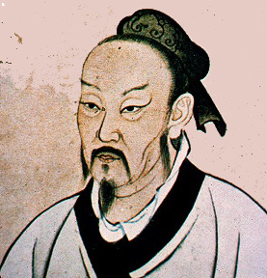
Mengzi and the Mengzi
Born perhaps a century after Kongzi’s death; the trends to which Kongzi was reacting have accelerated.
Speaking to “Kings” and various students, advises on personal cultivation and on socio-political organization
Introduces a more robust psychological account than Kongzi; basic emotions as our starting point.

Slide 20
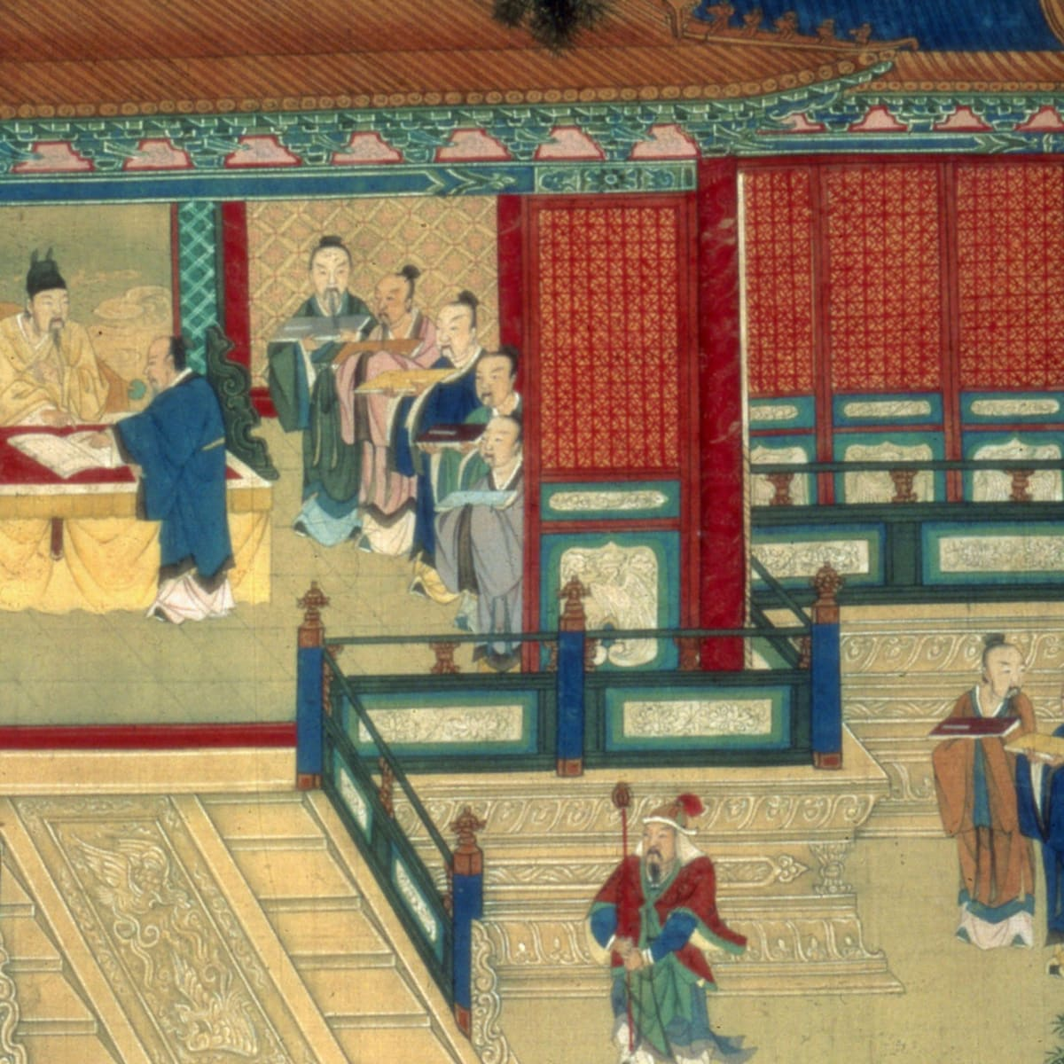
Mengzi 1A:7 — Explication
“What must one’s Virtue be like so that one can become King?”
De 德 = virtue
“One cares for the people and becomes King. This is something no one can stop.”
“Can one such as ourselves care for the people?”
“This heart is sufficient to become King.”
Xin 心 = heart, heartmind

Slide 21

Mengzi 1A:7 & 1B:5 — Basic Reactions
What reactions (feelings, emotions) are key to 1A:7?

Slide 22
Mengzi 1A:7 & 1B:5 — Basic Reactions
What reactions (feelings, emotions) are key to 1A:7?
Care for people
Inability to bear suffering of ox
Treat elders as elders …

Slide 23
Mengzi 1A:7 & 1B:5 — Basic Reactions
What reactions (feelings, emotions) are key to 1A:7?
Care for people
Inability to bear suffering of ox
Treat elders as elders …
What reactions are key to 1B:5?

Slide 24
Mengzi 1A:7 & 1B:5 — Basic Reactions
What reactions (feelings, emotions) are key to 1A:7?
Care for people
Inability to bear suffering of ox
Treat elders as elders …
What reactions are key to 1B:5?
Fond of wealth
Fond of sex

Slide 25
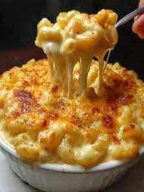
Mengzi 6A:14-15 — Great and Petty Parts
“People care for each part of themselves ….[but] one does not harm the great parts for the sake of the petty parts…. People who are always eating and drinking are despised by others, because they nurture what is petty and lose what is great.” (6A14)
What are the petty parts?
What are the great parts?

Slide 26
Mengzi 6A:14-15 — Reflection…and Reason?
“It is not the function of the ears and eyes to reflect (si 思), and they are misled by things. Things interact with other things and simply lead them along. But the function of the heart is to reflect. If it reflects, then it will get it.... If one first takes one’s stand on what is greater, then what is lesser will not be able to snatch it away.” (6A15)
What does it mean to “reflect”? What about to “take a stand (li 立)”?
Is the “heart (xin 心)” akin to Plato’s “reason”?

Slide 27
Mengzi 6A:14-15 — Mengzian Psychology
Mengzi holds that we have two types of emotional dispositions:
Physical (e.g., mouth’s desire for delicious flavor)
Socio-moral (e.g., king’s concern for ox)

Slide 28
Mengzi 6A:14-15 — Mengzian Psychology
Mengzi holds that we have two types of emotional dispositions:
Physical (e.g., mouth’s desire for delicious flavor)
Socio-moral (e.g., king’s concern for ox)
The emotions can be nurtured or neglected
When the socio-moral ones are strengthened, they can become reliable virtues – more Wednesday

Slide 29
Mengzi 6A:14-15 — Mengzian Psychology
Mengzi holds that we have two types of emotional dispositions:
Physical (e.g., mouth’s desire for delicious flavor)
Socio-moral (e.g., king’s concern for ox)
The emotions can be nurtured or neglected
We can choose – at least to some degree – how to direct our attention (“reflect,” “take a stand,” “set one’s heart on (zhi 志)”)

Slide 30
Mengzi 6A:14-15 — Mengzian Psychology
Mengzi holds that we have two types of emotional dispositions:
Physical (e.g., mouth’s desire for delicious flavor)
Socio-moral (e.g., king’s concern for ox)
The emotions can be nurtured or neglected
We can choose – at least to some degree – how to direct our attention (“reflect,” “take a stand,” “set one’s heart on (zhi 志)”)
These are abilities of one’s heart, rather than a separate faculty of “reason”

